Slide 1
MS1
Project/Client Presentation

Slide 2
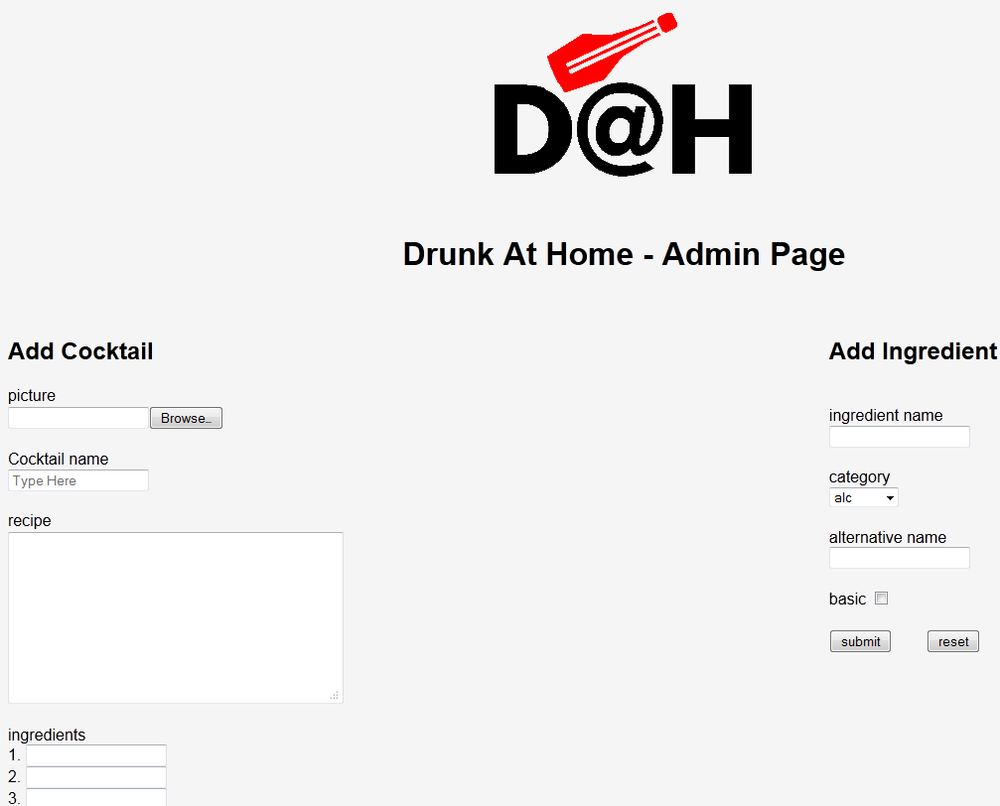
Website UI
Admin UI:
Fully Working (Able to add both Ingredients & Cocktails)

Slide 3

Website UI - Continued
Search By Name:
Now features auto-complete from the server’s DB
Works! (try it! http://drunkathome.no-ip.org)

Slide 4
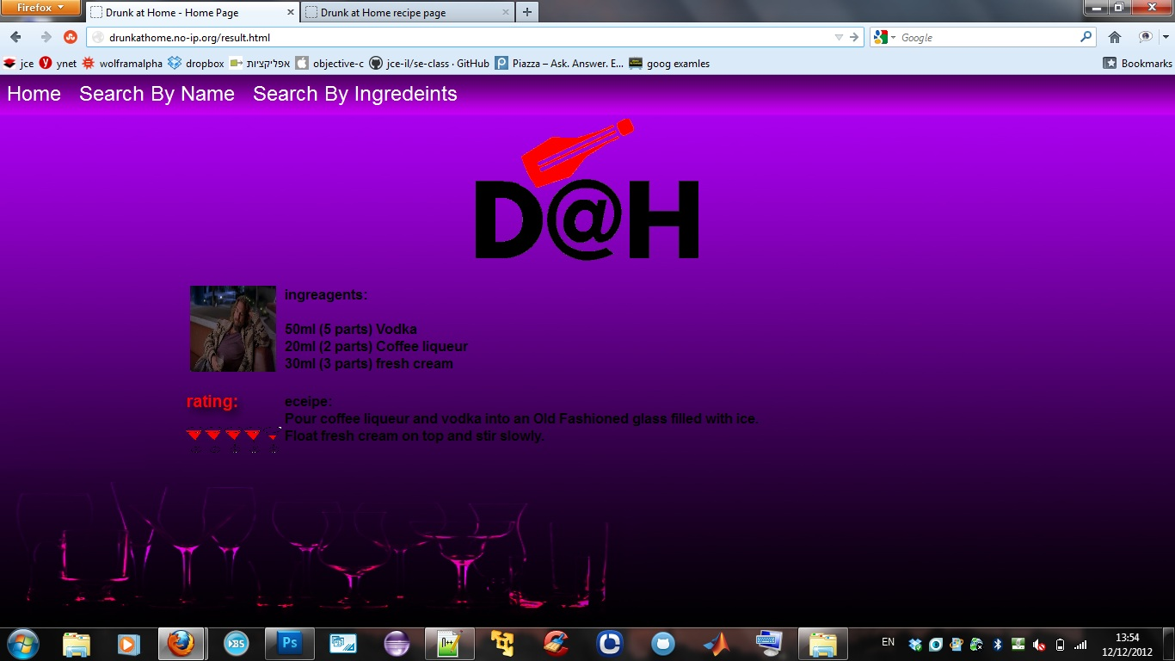
Website UI - Continued
Basic Single Recipe Page
Needs a little refactoring… (page design…)

Slide 5
SERVER
The Ubuntu LAMP (Linux,Apache,MySQL,Perl/PHP) server deployed in MS0 was Stress-Tested (20 users, all running queries using the Admin UI)
Security patches and strict access policy were applied to the server.

Slide 6
MS2
Leading User Story:
“ As a Drunk@Home User,
I would like to search for Cocktails
By inputing the Ingredients I have at home.
“
As Title says: we will be focusing on “search By Ingredients”

